Slide 1
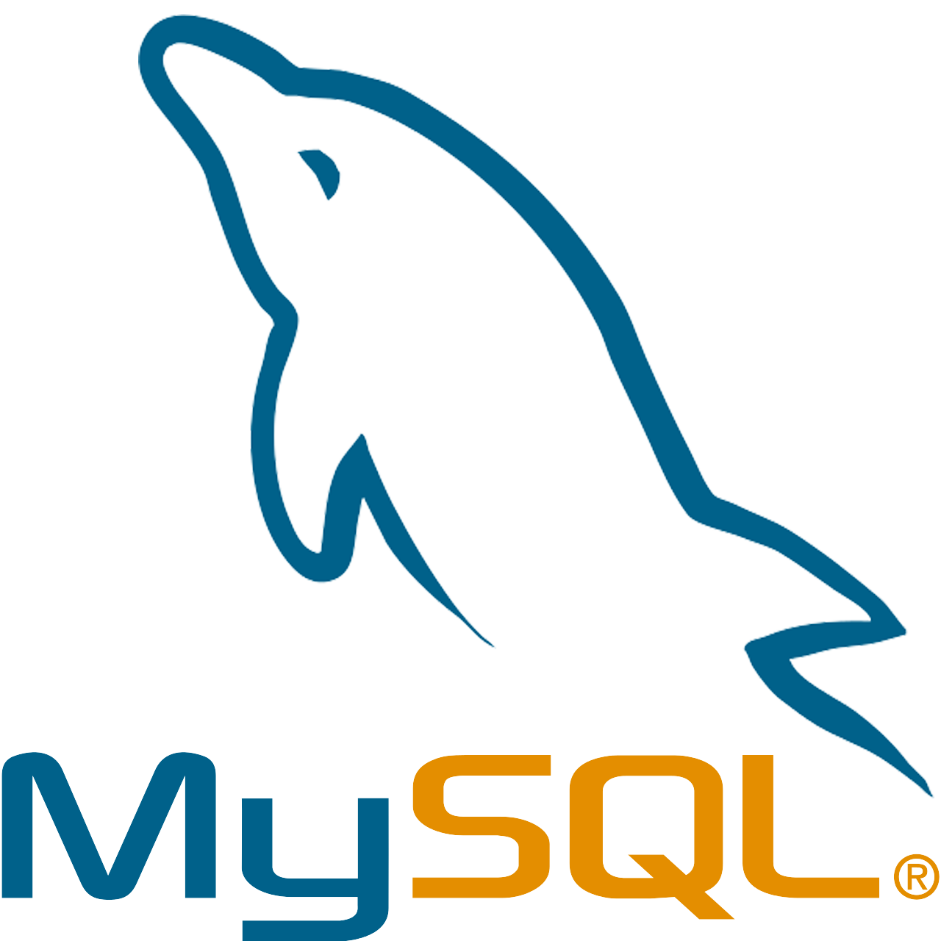

Procedural Language SQL – PL/SQL
M Febrian Rachmadhan Amri, S.TI., M.Kom.

Slide 2
What is PL/SQL?
PL/SQL is a procedural language that is used to extend the functionality of the SQL language. It is the proprietary procedural extension language for Oracle Database.
PL/SQL allows developers to create program units that are executed within the database server. These program units can be used to create stored procedures, functions, triggers, views, and other database objects that can be called from within SQL statements or other PL/SQL program units.

Slide 3
What is PL/SQL?
PL/SQL supports procedural constructs such as loops, conditional statements, variables, and exception handling, which makes it possible to write complex business logic that can be executed within the database. This can lead to better performance and reduced network traffic compared to executing the same logic on the client-side.
Some of the key features of PL/SQL include:
Integration with SQL statements
Support for procedural constructs such as loops, conditional statements, and variables
Exception handling
Support for stored procedures, functions, and triggers
Integration with other programming languages and technologies
Overall, PL/SQL is a powerful language that is widely used for developing applications on the Oracle Database platform. It allows developers to create complex, high-performance applications that can be executed entirely within the database.

Slide 4
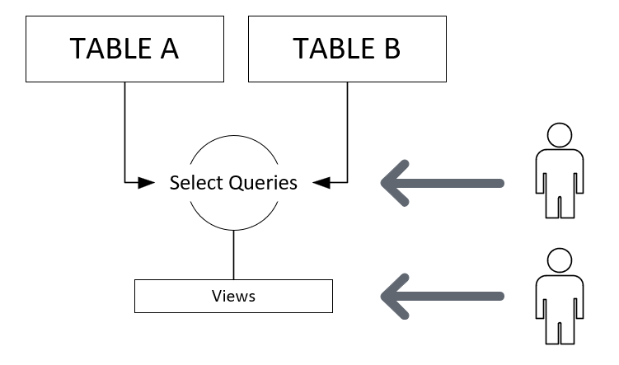
PL/SQL
Views

Slide 5
PL/SQL: Views
MySQL views are virtual tables that are created by defining a SELECT statement and stored in the database. A view can be thought of as a saved query that can be used like a table in SQL statements. Views can simplify complex queries, improve security, and provide a consistent interface to the database.
Views can also be used to improve security by restricting access to sensitive data in the underlying tables. For example, a view can be created that retrieves only a subset of the columns from a table, or that filters the rows based on certain criteria. This way, users who have access to the view can only see the data that they are authorized to see.

Slide 6
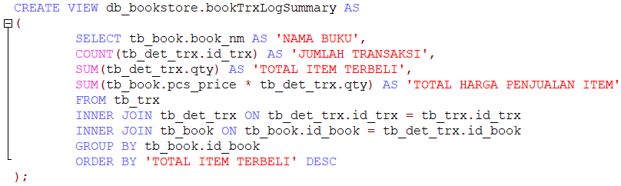
PL/SQL: Views
Create Views of Book Transaction Log Summary:

Slide 7
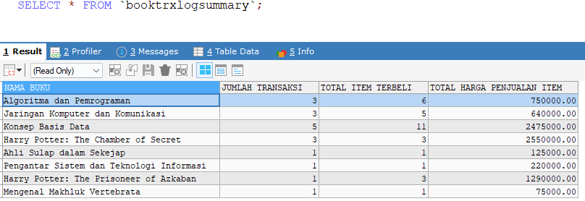
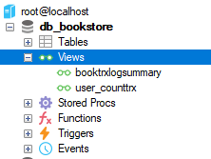
Select Views
Views on SQLyog

Slide 8
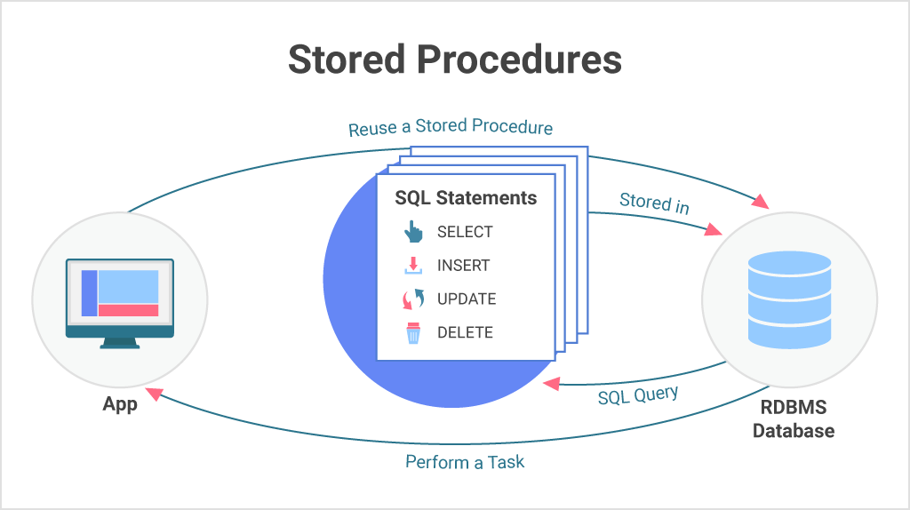
PL/SQL
Stored Procedures

Slide 9
PL/SQL: Stored Procedures
MySQL stored procedures are programming blocks that are stored in the MySQL server and can be executed on demand. Stored procedures are created using the MySQL CREATE PROCEDURE statement and can accept parameters, execute SQL statements, and return results.
Stored procedures can be used to perform complex operations, execute multiple SQL statements, and return multiple result sets. They are often used to encapsulate business logic, improve performance, and simplify application development by providing a reusable interface to the database.

Slide 10
PL/SQL: Stored Procedures
SP Pattern:
DELIMITER$$ CREATE PROCEDURE procedure1() BEGIN /* procedure body */ END$$ DELIMITER;
SP Call Pattern to execute the process:
CALL procedure1();

Slide 11
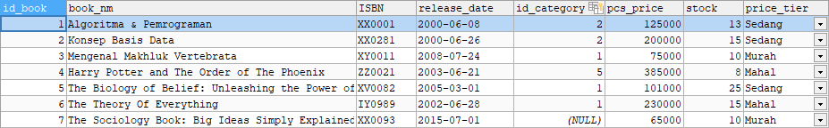
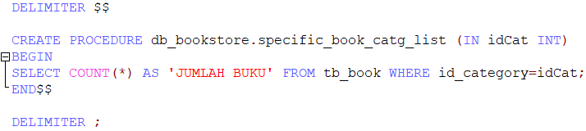
PL/SQL: Stored Procedures
tb_book:
Create SP of specific book category list:

Slide 12
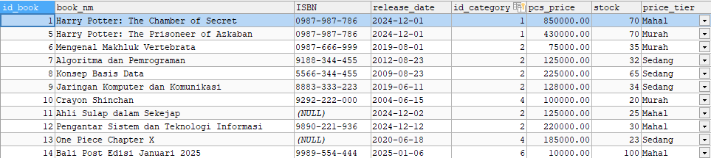
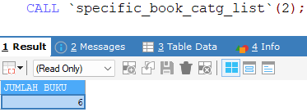
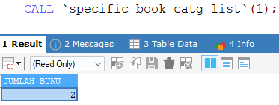
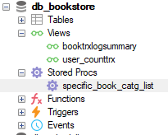
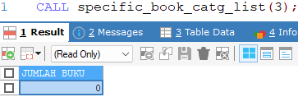
PL/SQL: Stored Procedures
Call Stored Procedures:
SP on SQLyog

Slide 13
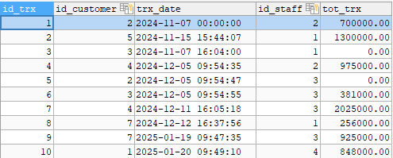
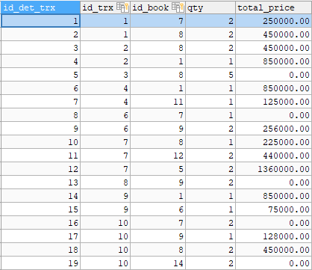
PL/SQL: Another Example of SP
tb_trx:
tb_det_trx:

Slide 14
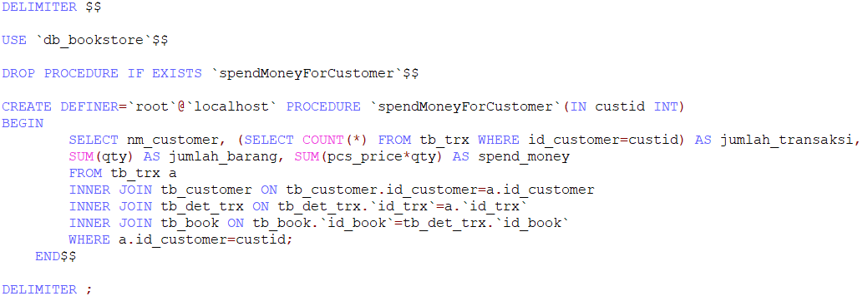
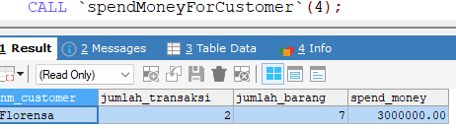
PL/SQL: How to Show Customer Trx Report
Create SP of Spesific Customer Transaction Report:
Output:

Slide 15
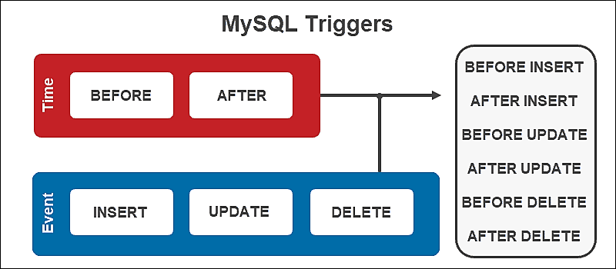
PL/SQL
Triggers

Slide 16
PL/SQL: Triggers
MySQL triggers are special stored programs that are automatically executed in response to certain events, such as the insertion, update, or deletion of data in a table. Triggers are defined using the MySQL CREATE TRIGGER statement and can be used to perform various tasks, such as auditing changes to data, enforcing business rules, and maintaining referential integrity
Triggers can be used for a variety of purposes, such as:
Auditing changes to data
Enforcing business rules and constraints
Maintaining referential integrity
Automatically populating data in other tables
Updating denormalized data
Validating data before it is inserted or updated

Slide 17
PL/SQL: Triggers – Before and After Explanation
A BEFORE trigger is executed before the statement that triggered it is executed. This means that you can use a BEFORE trigger to modify the values that are being inserted, updated or deleted, or to perform some other action before the statement is executed.
For example, you could use a BEFORE trigger to automatically set the value of a field based on the values of other fields in the same row
AFTER trigger: An AFTER trigger is executed after the statement that triggered it is executed. This means that you can use an AFTER trigger to perform some action after the statement has been executed
For example, you could use an AFTER trigger to log the changes that were made to a table or to send an email notification to users when a new record is inserted into a table.

Slide 18
PL/SQL: Triggers
Trigger:
DELIMITER$$ CREATE TRIGGER [trigger_name] [BEFORE/AFTER INSERT/UPDATE/DELETE] ON [table_name] FOR EACH ROW BEGIN -- SQL Statement -- END$$ DELIMITER;

Slide 19
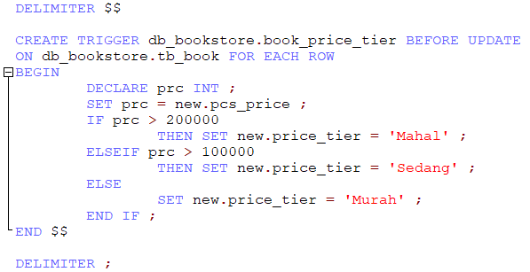
PL/SQL: Before Update Example
Create Triggers to update price value after the pcs price changes:

Slide 20
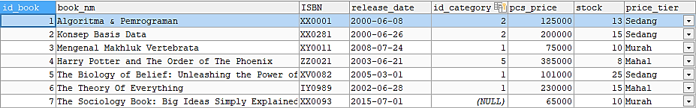
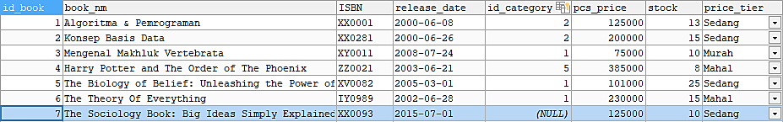
PL/SQL: Triggers
Before price update:
After price update:

Slide 21
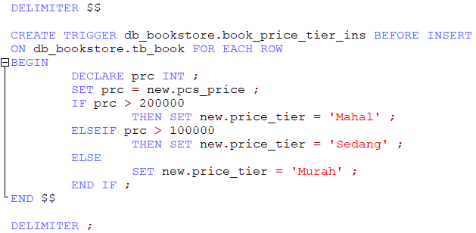
PL/SQL: Before Insert Example
Create Triggers to update price value after data insertion process:
Price Tier Column the data will be automatically filled with the value we set on Trigger

Slide 22
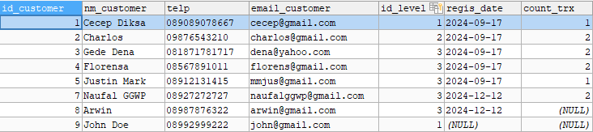
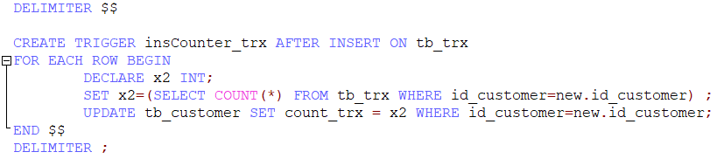
PL/SQL: After Insert Example
Create Triggers to count user transaction:

Slide 23
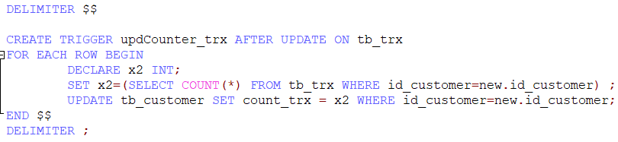
PL/SQL: After Update Example
Create Triggers to count user transaction:

Slide 24
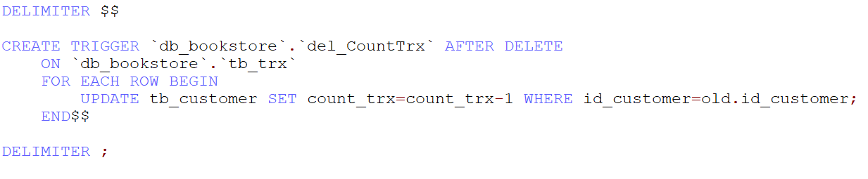
PL/SQL: After Delete Example
Create Triggers to decrement counter user transaction:

Slide 25
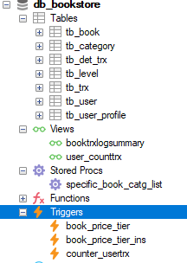
PL/SQL: Trigger Location on RDBMS
Triggers on SQLyog
In summary, the main difference between a BEFORE trigger and an AFTER trigger is the timing of their execution. The BEFORE trigger is executed before the statement that triggered it is executed, while the AFTER trigger is executed after the statement has been executed.

Slide 26

Discussion Session
Any Question?

Slide 27

Practice Session
Lets do it!

Slide 28
TUGAS!!!
Buat Views yang bisa menampilkan berapa kali sebuah buku sudah pernah dibeli.
Buatlah Views yang menampilkan buku dan semua genre dari masing-masing buku dalam satu baris.
Buat Stored Procedures yang bisa dipanggil untuk merekap jumlah Genre yang paling sering diminati pembeli.
Buat Triggers yang bisa secara otomatis meng-update ataupun menginput kolom total_price pada tabel detail transaksi Ketika adanya perubahan data detail transaksi.
Kumpulkan ke email dengan subject: TBD_TugasPLSQL_NIM

